Slide 1

Advanced Brain Tumor Segmentation using Duck-Net Under the Guidance of Prof. Dr. Victor S. Sheng ( Victor.sheng@ttu.edu )
Couse Name: Neural Networks, Course Number: CS5388
Presented By:
Shreyas Prabhakar R11894057
Shiva Sai Pavan R11895341
Suman Majjari R11911984
Talha Jabbar R11914715
Aditya Madala R11903231
December 3, 2024

Slide 2
Table of Contents
Sl. No | Section | Description
2 | Problem statement and Recap | Problem statement and midterm recap
3 | Flowchart | Project workflow
4 | About BraTS 2020 And Data Preprocessing | Overview of the BraTS 2020 dataset ,Steps involved in preparing the data for training
5 | Data Augmentation | Techniques used to augment the dataset
6 | Ducknet Architecture | Description of the proposed Ducknet architecture
7 | Model Compilation and Technical Specification | Details on how the model is compiled
8 | Model Training and Evaluation | Procedure for training and evaluating the model
9 | Segmentation Results | How the results are presented visually
10 | Results comparison across different Architectures | Table presenting precision for varying dataset sizes
11 | Conclusion | Summary of the work
12 | Acknowledgement | Acknowledgments to individuals or organizations
Department of Computer Science
-1-
Neural Networks ( Course Number:CS5388 )

Slide 3
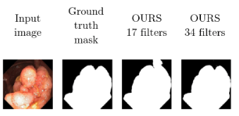
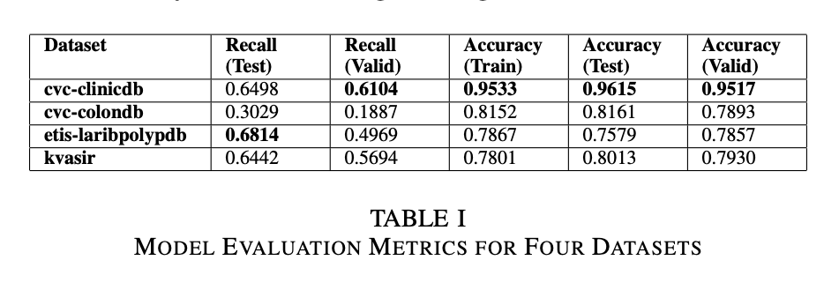
Problem Statement and Recap
Task Objective: Precisely identify tumor regions within MRI scans.
Challenges: Tumor variability in shape, size, and appearance poses significant challenges for traditional segmentation methods.
Solution:
Utilize advanced deep learning architectures like Duck-Net to enhance segmentation performance.
Incorporate dense blocks and skip connections to improve feature extraction and spatial information retention.
Fig1: Polyp representation and ground truth
Department of Computer Science
-2-
Neural Networks ( Course Number:CS5388 )

Slide 4
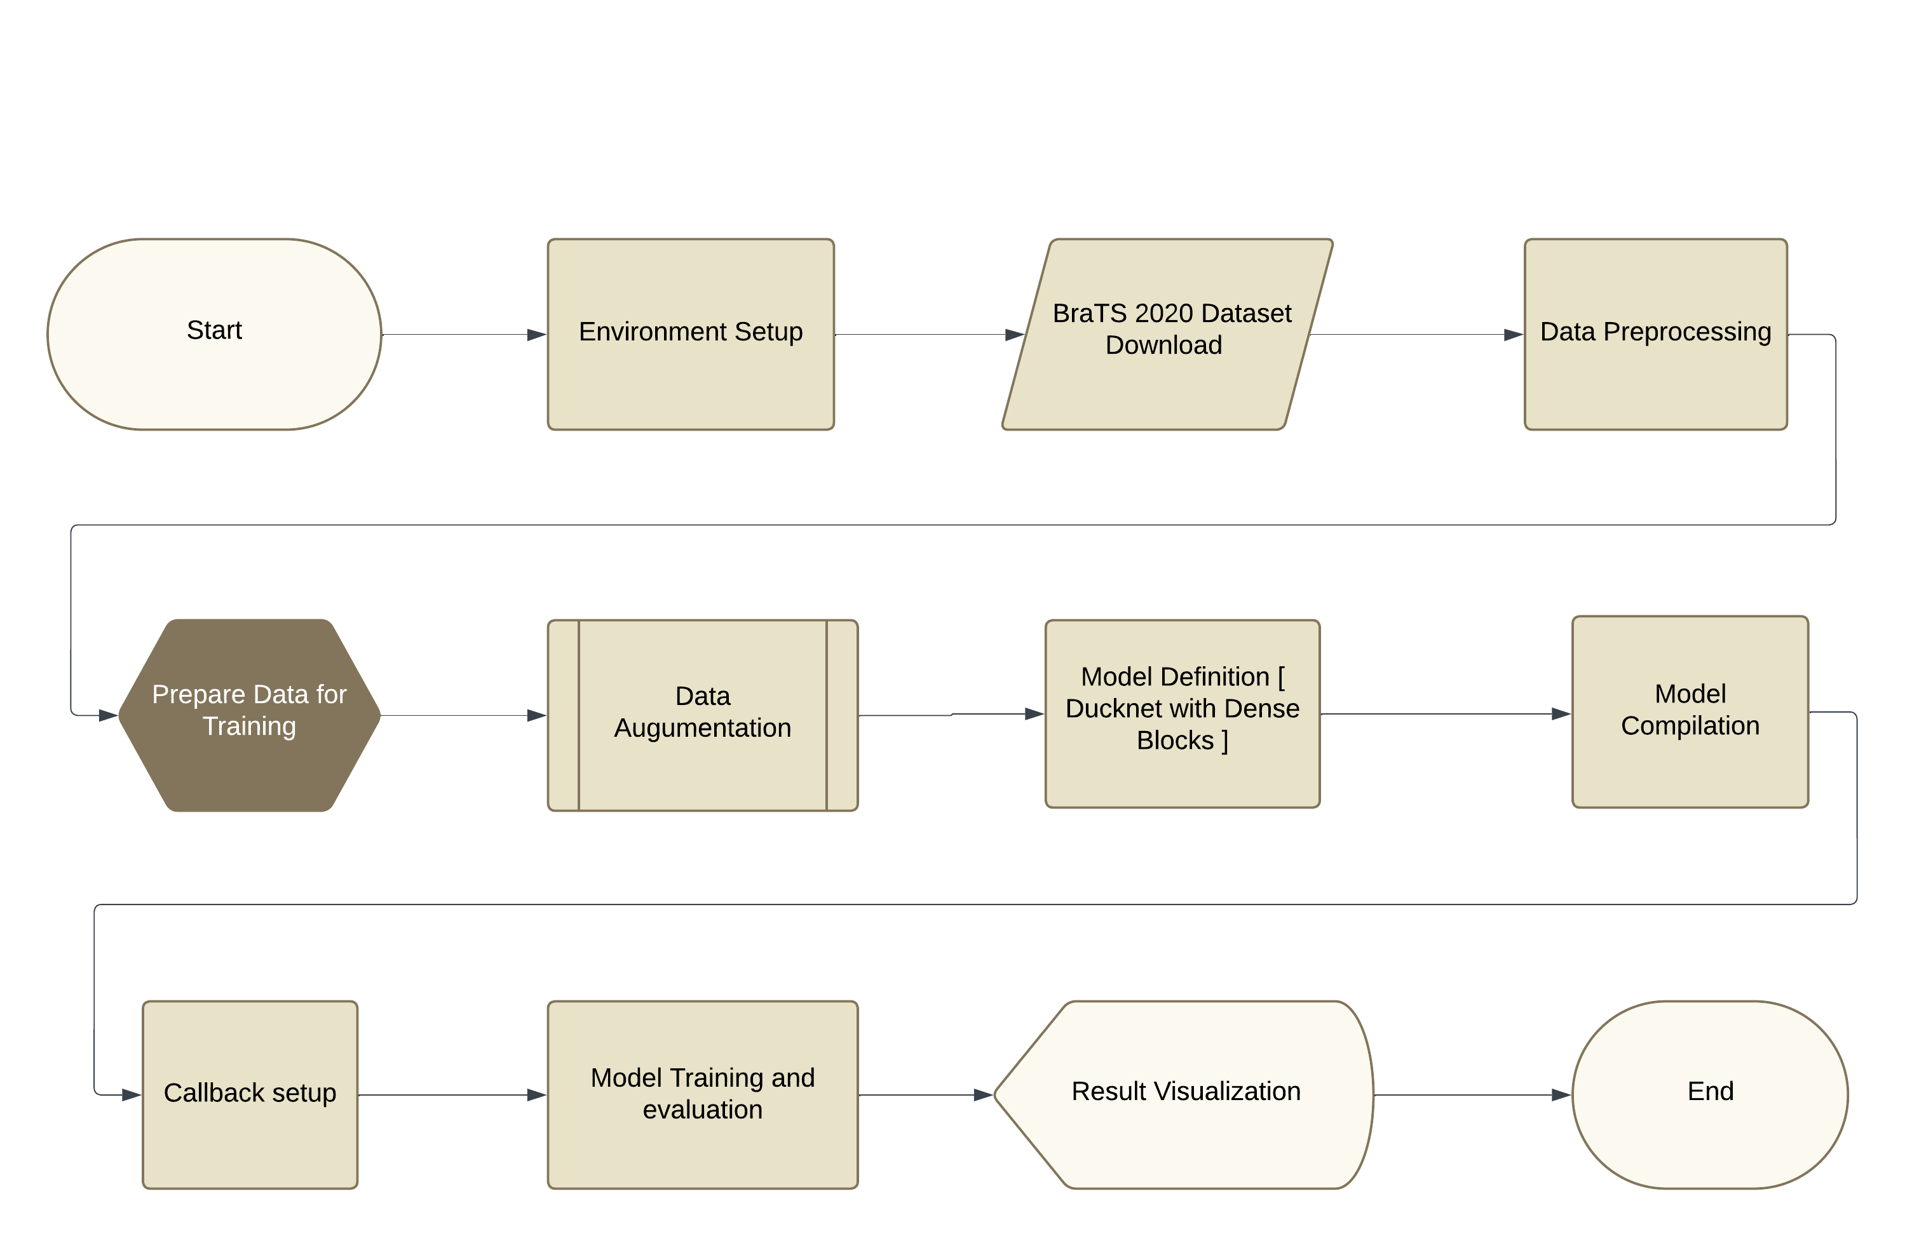
Flowchart ( Project workflow )
Fig1: Project workflow diagram
Department of Computer Science
-3-
Neural Networks ( Course Number:CS5388 )

Slide 5
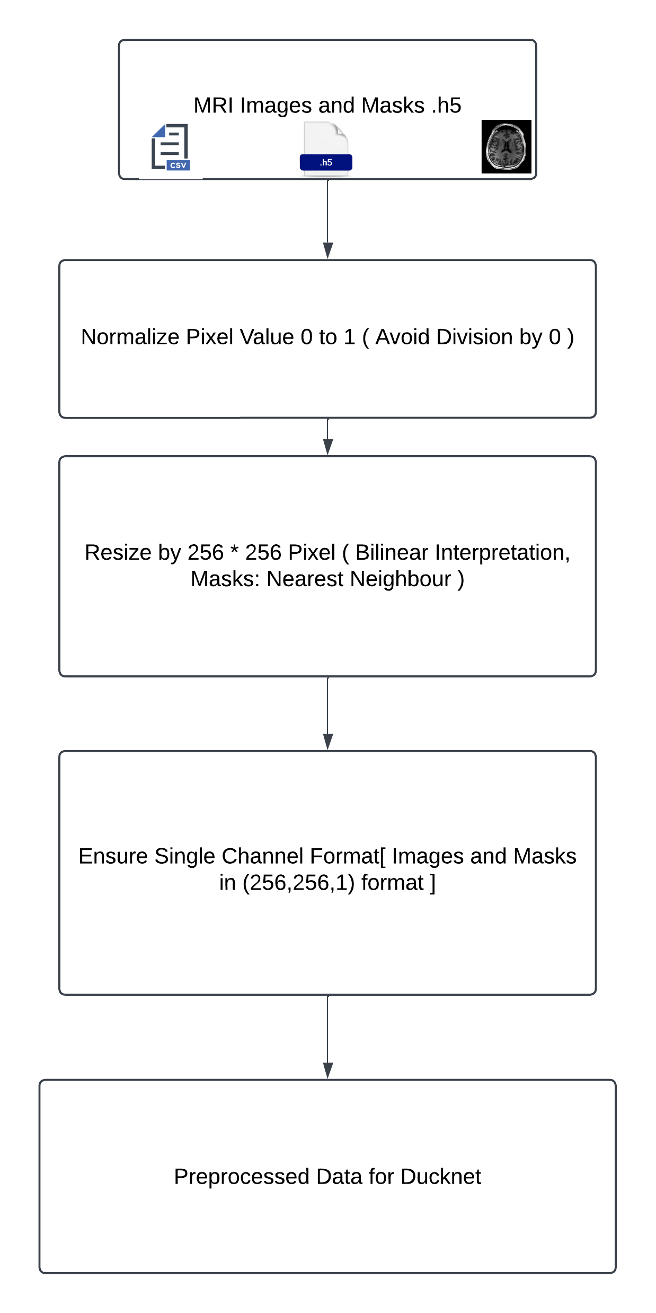
BraTS 2020 Dataset and Preprocessing
Fig2: DUCKNet Data Preprocessing Pipeline
Department of Computer Science
-4-
Neural Networks ( Course Number:CS5388 )

Slide 6
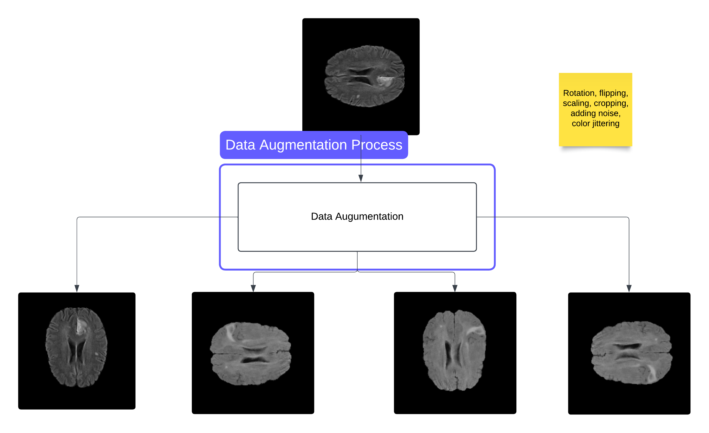
Data Augmentation Process
Diagram information
This flowchart outlines the steps involved in data augmentation, detailing the sequence of actions from initial data input to augmented data output. Key steps include pre-processing, augmentation techniques, and validation.
Data Augmentation Procedure
1. Begin with the initial data input.
2. Perform initial data pre-processing.
2.1. Clean the data.
2.2. Normalize the data format.
3. Apply the selected data augmentation techniques.
3.1. Choose appropriate augmentation methods.
3.2. Implement augmentation algorithms.
4. Validate the augmented data.
4.1. Ensure data integrity.
4.2. Verify data utility for intended purpose.
5. Output the augmented data for further use.
Fig3: Representation of Data Augmentation Process
Department of Computer Science
-5-
Neural Networks ( Course Number:CS5388 )

Slide 7
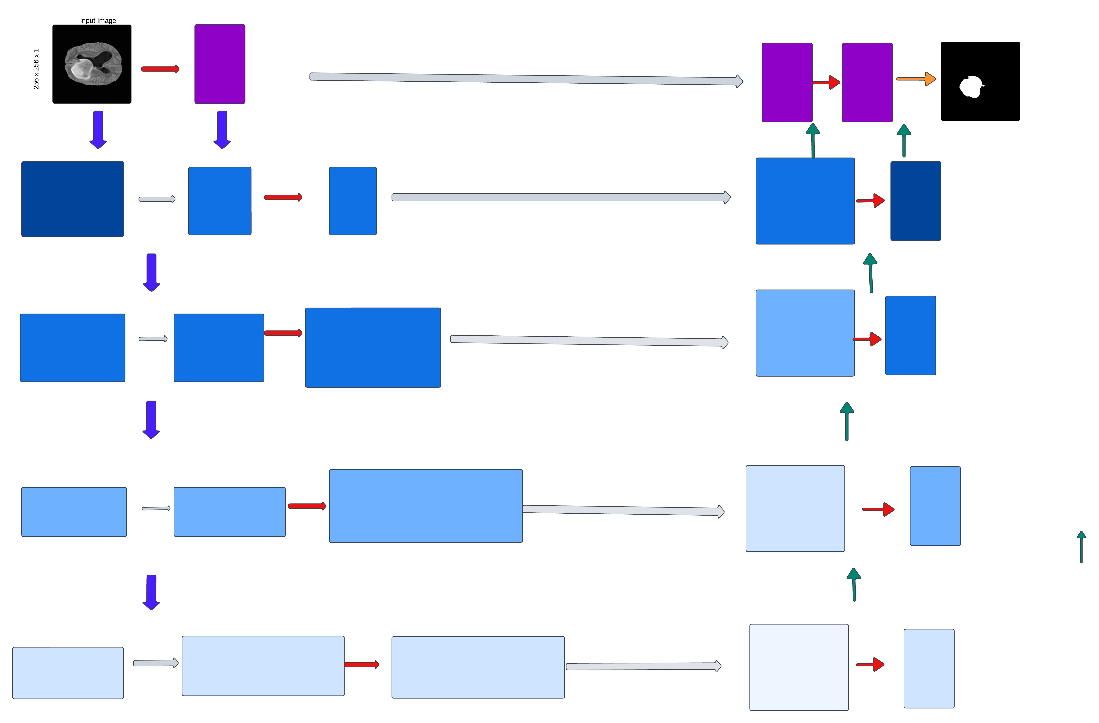
Ducknet Architecture
Output Segmentation map
256 x 256
256 x 256
256 x 256
256 x 256
Output image (Trained Image)
Dense Block 2
Max Pooling
64 filters
Dense Block 9
Conv2D
Down sampling
Max Pooling
Dense Block 8
Conv2D
Up sampling
Dense Block 3
128 Filters
Dense Block 4
Max Pooling
256 Filters
Dense Block 7
Conv2D
Nearest Up sampling
Duck
Convolution Block with Kernel Size and Strides of 2
Dense Block 5
Max Pooling
512 Filters
Dense Block 6
Conv2D
Convolution block with kernel size of 1 followed by Sigmoid Activation Function
Addition
Fig. 4: Architecture diagram of DUCKNet using UNet and DenseNet
Department of Computer Science
-6-
Neural Networks ( Course Number:CS5388 )

Slide 8
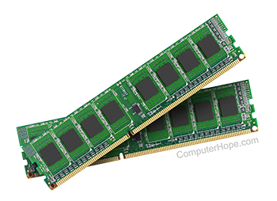
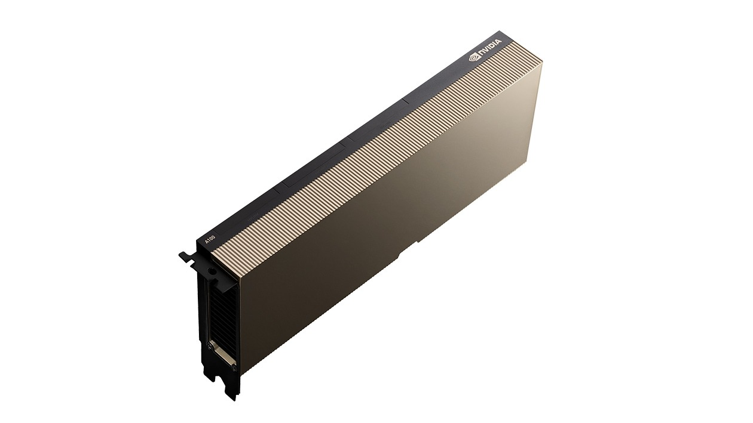
Model Compilation and Technical Specification
Framework and Model Compilation:
Framework: TensorFlow with Keras API
Optimizer: Adam with learning rate 1e-4.
Loss Function: Binary Crossentropy
Metrics:
Accuracy
Dice Coefficient
Mean IoU
Training Setup:
Batch Size: 8
Epochs: Up to 300 with early stopping
Technical Specifications:
Environment: Python 3 on Google Compute Engine
System Resources:
RAM: 51 GB
Disk Space: 225.8 GB
GPU: NVIDIA A100 with 40 GB memory
Fig5: shows the ram and GPU’s appearance.
Department of Computer Science
-7-
Neural Networks ( Course Number:CS5388 )

Slide 9
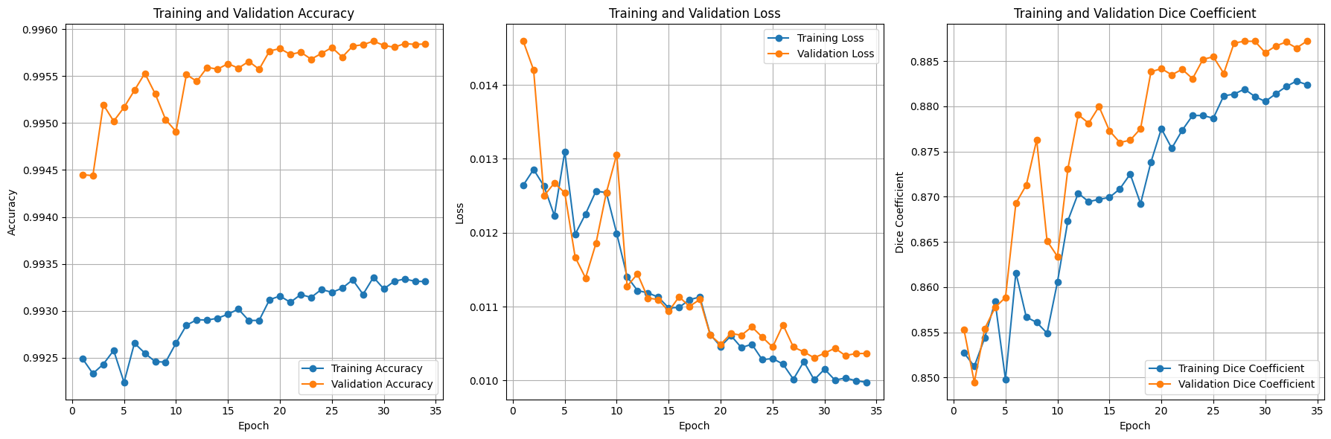
Model Training and Evaluation
Performance Graphs | Description | Observation
Training and Validation Accuracy | This graph shows the accuracy of the model over a series of epochs for both training and validation datasets. | The validation accuracy is higher than the training accuracy, indicating good generalization.
Training and Validation Loss | This graph depicts the loss values over epochs, which measures how well the model’s predictions match the true labels. | Both training and validation loss decrease over time, showing that the model is learning effectively.
Training and Validation Dice Coefficient | The Dice coefficient is a metric specifically used for evaluating segmentation tasks, indicating how well the predicted segmentation matches the ground truth. | An increasing Dice coefficient suggests improved segmentation performance as training progresses.
Fig. 5: Performance Graph Representation
Department of Computer Science
-8-
Neural Networks ( Course Number:CS5388 )

Slide 10
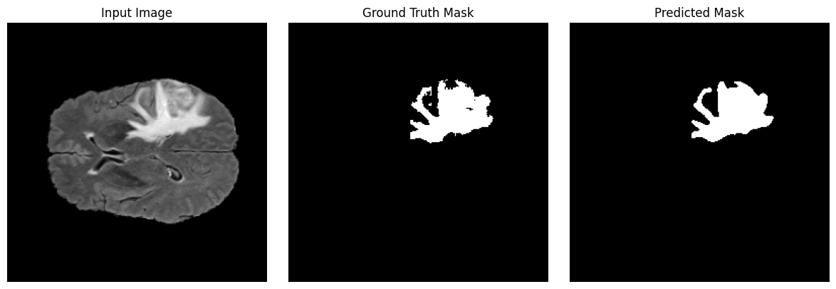
Segmentation Results
Input Image: Displays a medical image (likely an MRI scan) used as input for the segmentation model.
Ground Truth Mask: Shows the actual mask indicating the region of interest, used as a reference for evaluating the model's performance.
Predicted Mask: Illustrates the mask predicted by the model, highlighting how well it matches the ground truth.
Fig. 6: Segmentation result to detect a polyp on a brain tumor.
Department of Computer Science
-9-
Neural Networks ( Course Number:CS5388 )

Slide 11
Results comparison across different Architectures
Metric | Model 1: 3D MRI Brain Tumor Segmentation | Model 2: U-Net | Model 3: U-Net + CNN (BRATS) | Model 4: DuckNet (U-Net + DenseNet)
Accuracy (Train) | 99.02% | 99.31% | 98.67% | 99.25%
Accuracy (Validation) | 98.91% | 99.31% | 98.34% | 99.57%-99.58%
Mean IoU | 77.16% (Train), 78.25% (Val) | 84.26% | N/A | N/A
Dice Coefficient (Train) | 48.73% | 64.8% | 35.89% | 88.14%
Dice Coefficient (Val) | 47.03% | 64.8% | 28.22% | 88.72%
Precision | 99.33% | 99.35% | 60.47% | High
Sensitivity (Recall) | 98.64% (Train), 98.56% (Val) | 99.16% | 63.97% | Moderate to High
Specificity | N/A | 99.78% | 98.74% | High
Validation Loss | N/A | 0.0267 | 0.0592 | 0.0103
Department of Computer Science
- 10 -
Neural Networks ( Course Number:CS5388 )

Slide 12
Conclusion
Model Performance: The validation accuracy consistently outperforms the training accuracy, indicating that the model generalizes well to unseen data. The loss curves for both training and validation datasets decrease steadily, demonstrating effective learning and convergence of the model.
Segmentation Quality: The Dice coefficient, a critical metric for segmentation tasks, shows improvement over epochs, suggesting that the model is accurately capturing the tumor regions.
Generalization and Overfitting: The higher validation accuracy compared to training accuracy suggests that the model is not overfitting and is robust in handling new data.
Future Directions: Further improvements could be explored by experimenting with different architectures or incorporating additional data augmentation techniques.Consider integrating transfer learning or fine-tuning on more diverse datasets to enhance model robustness. This analysis highlights Duck-Net’s effectiveness in segmenting brain tumors and its potential for clinical application in medical imaging.
Department of Computer Science
- 11 -
Neural Networks ( Course Number:CS5388 )

Slide 13
Acknowledgements and References
Acknowledgment:
Texas Tech University: We thank you for your invaluable support and resources.
Professor Victor Sheng: We appreciate your unwavering guidance and mentorship.
Computer Science Department: We acknowledge your collaborative environment and technical support.
BraTS 2020 Dataset Contributors: We gratefully acknowledge your contributions to our research.
Nature Article: We thank you for the insights gained from “https://www.nature.com/articles/s41598-023-36940-5” and its esteemed authors.
Reference:
Menze, B. H., et al. “The Multimodal Brain Tumor Image Segmentation Benchmark (BRATS).” IEEE Transactions on Medical Imaging, 2015.
Bakas, S., et al. “Advancing The Cancer Genome Atlas glioma MRI collections with expert segmentation labels and radiomic features.” Nature Scientific Data, 2017.
Department of Computer Science
- 12 -
Neural Networks ( Course Number:CS5388 )

Slide 14
Thank you
Department of Computer Science
- 13 -
Neural Networks ( Course Number:CS5388 )

